Slide 1
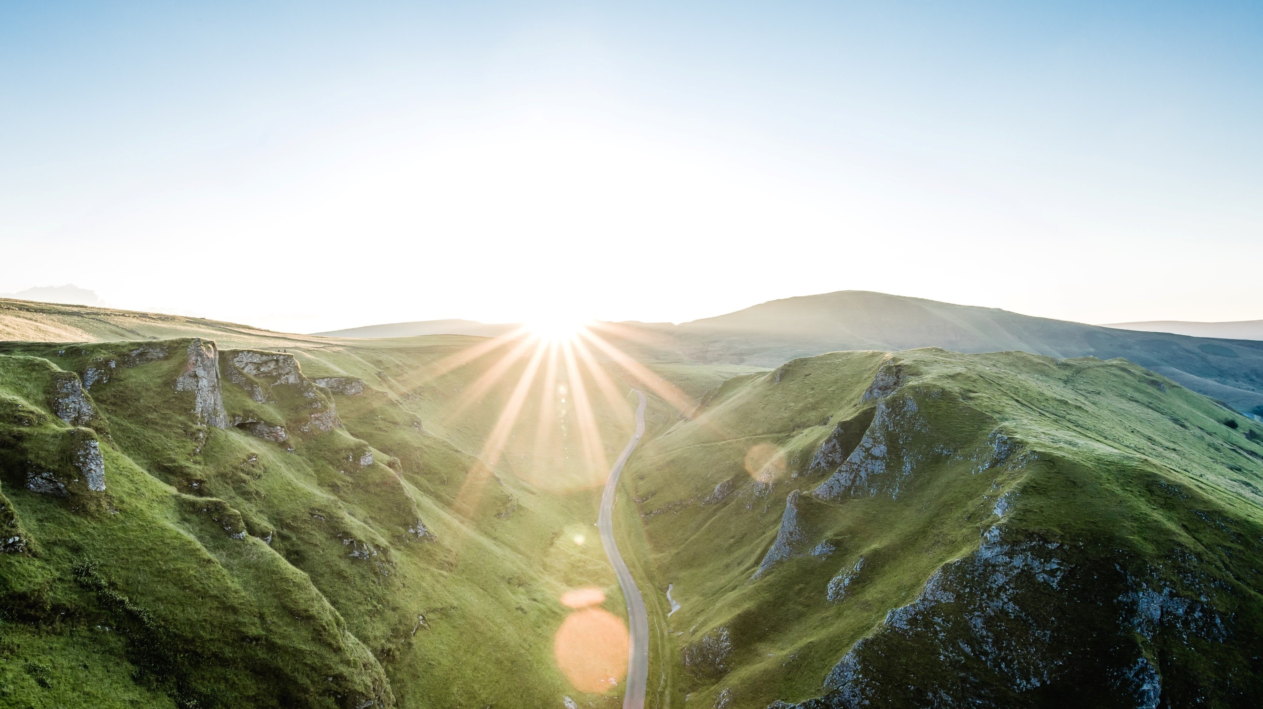
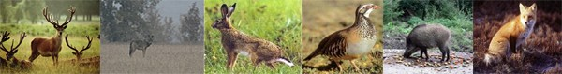
Kaggle Project Final 2022
Hadas Sela | 316312842
Assaf Ashkenazi | 207172370

Slide 2
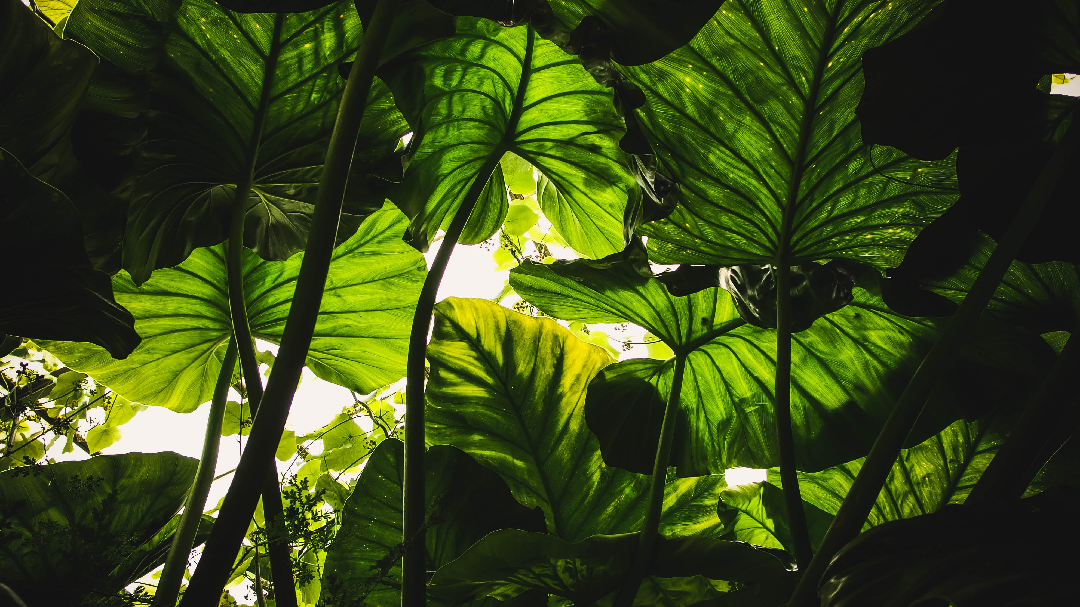
Content
Challenges
Exploratory Data Analysis
Data Pre-processing
Model
Results
References

Slide 3
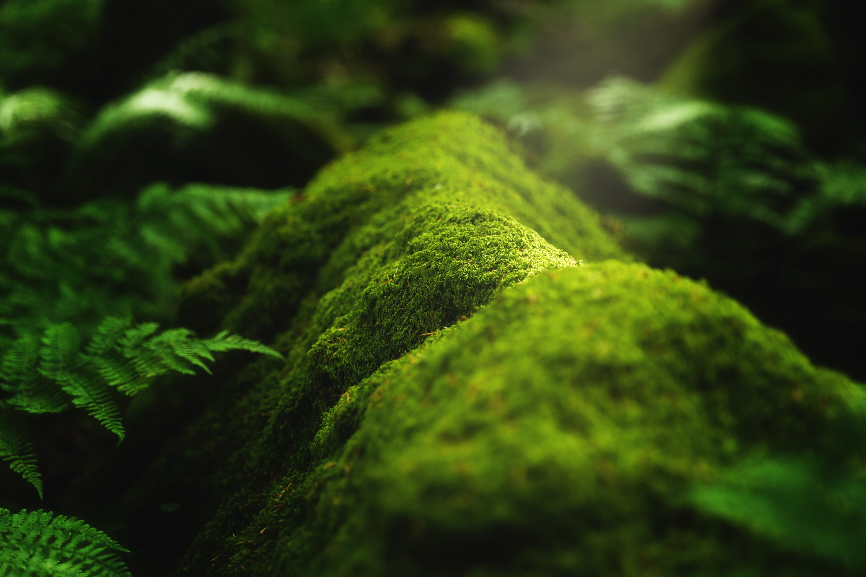
Challenges
{{
Sources:
“iWildCam 2019 Competition” site [1]
“Welcome to iWildCam 2019 - FGVC6!” [2]
Camera trap data provides several challenges that can make it difficult to achieve accurate results.
“Both the train and test sets contain pictures of animals, but the types of animals are largely different between the two sets.” [2]

Slide 4
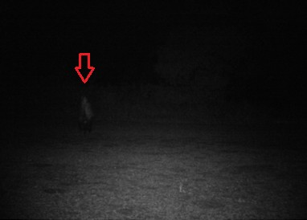
Challenges (A) -Illumination
Images can be poorly illuminated, especially at night. The example below contains a skunk to the center left of the frame.

Slide 5
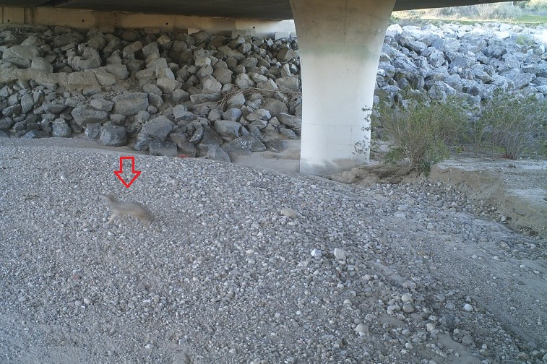
Challenges (A) -Motion Blur
The shutter speed of the camera is not fast enough to eliminate motion blur, so animals are sometimes blurry. The example contains a blurred coyote.

Slide 6
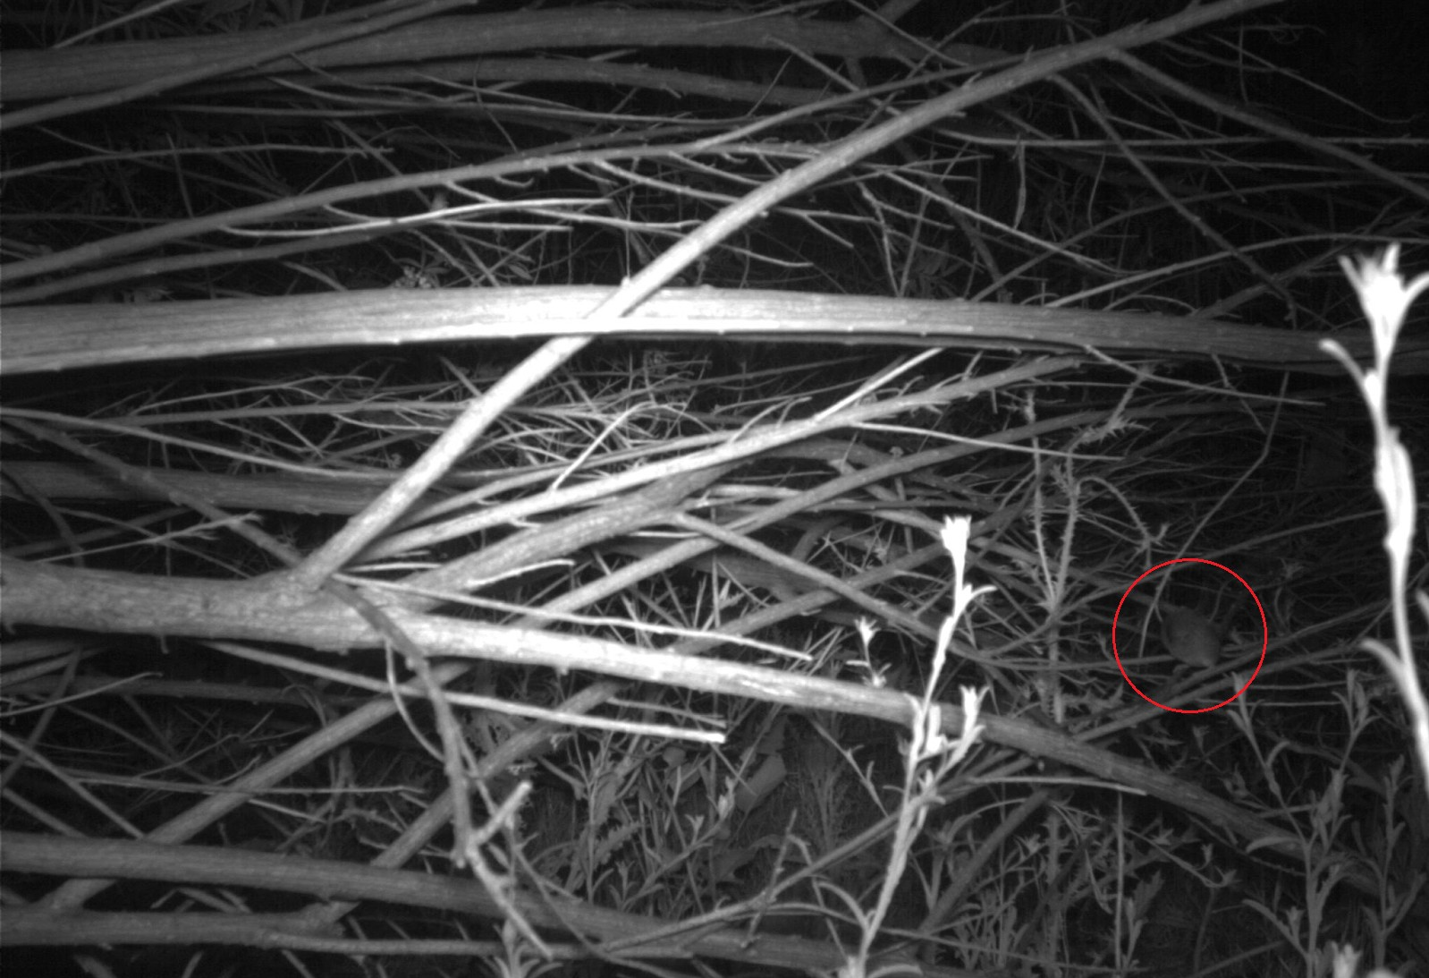
Challenges (A) -Small Region of Interest (ROI)
Some animals are small or far from the camera, and can be difficult to spot even for humans. The example image has a mouse on a branch to the center right of the frame.

Slide 7
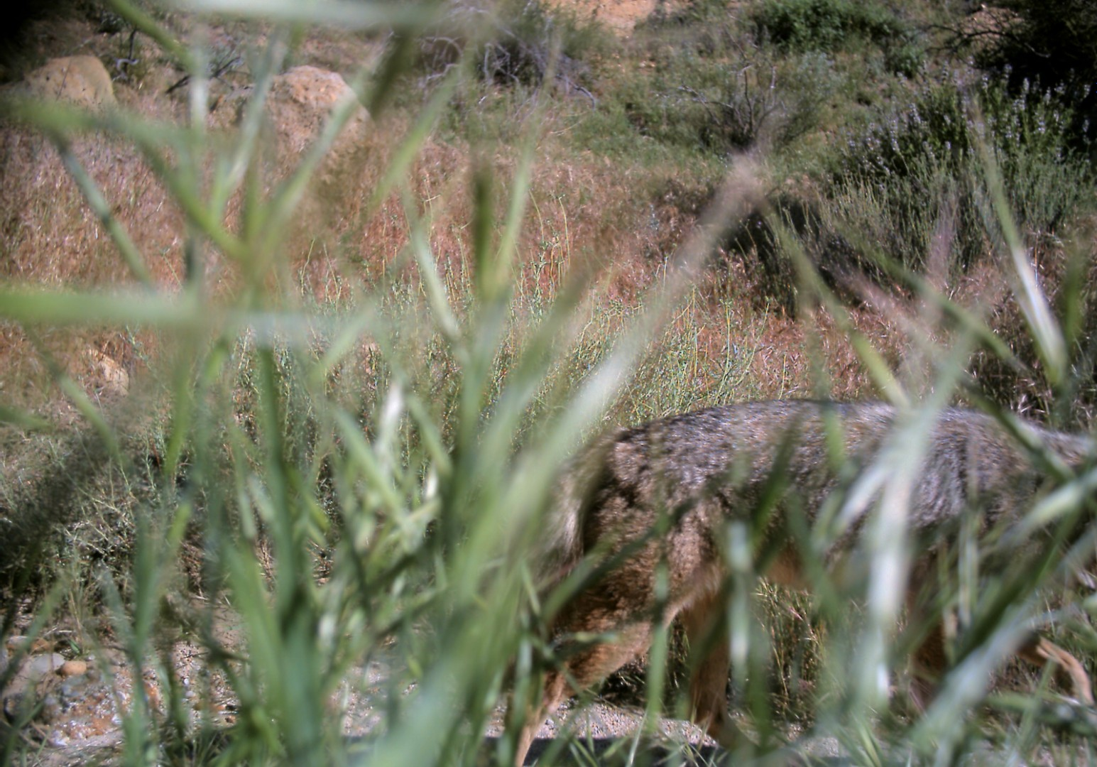
Challenges (A) -Occlusion
Animals can be occluded by vegetation or the edge of the frame. This example shows a location where weeds grew in front of the camera, obscuring the view.

Slide 8
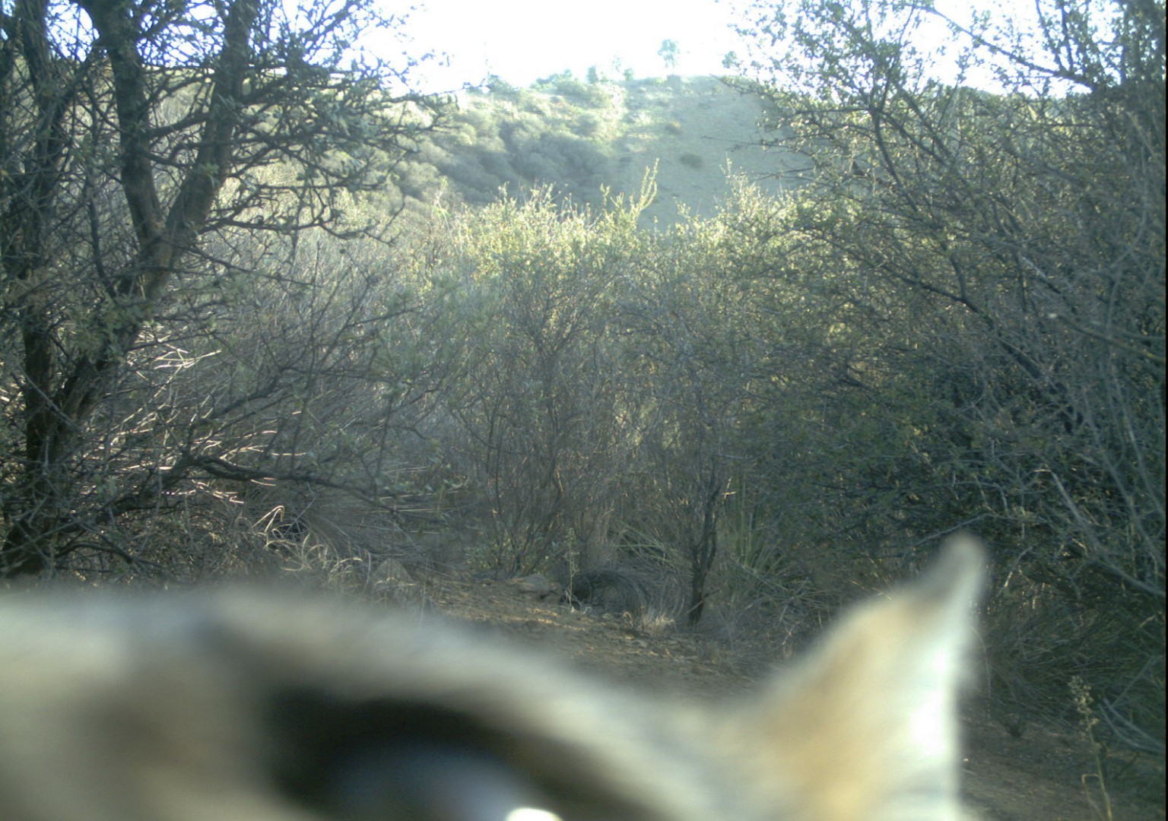
Challenges (A) -Perspective
Sometimes animals come very close to the camera, causing a forced perspective.

Slide 9
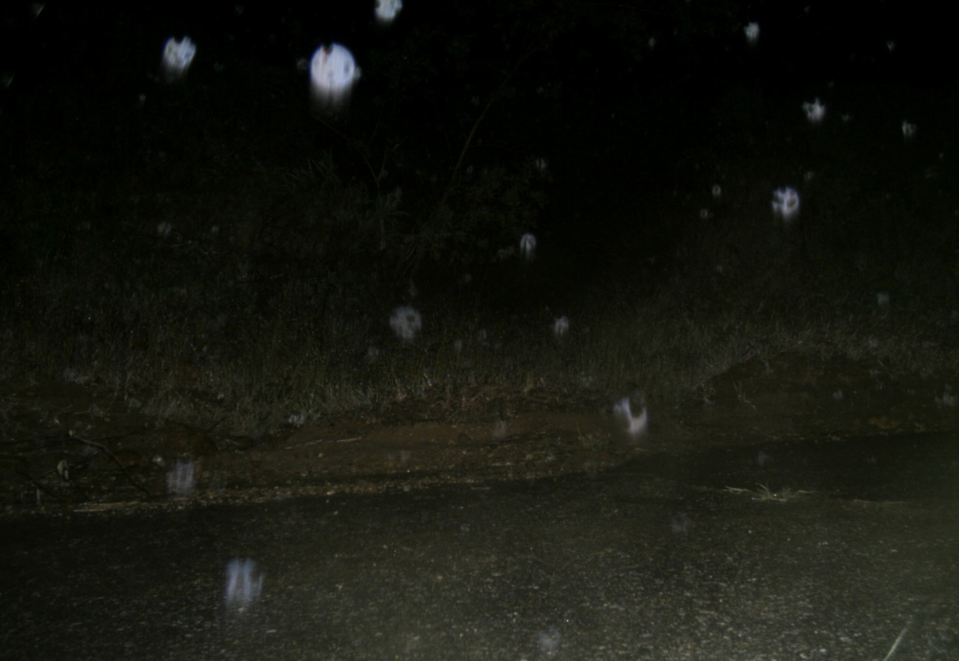
Challenges (A) -Weather Conditions
Poor weather, including rain, snow, or dust, can obstruct the lens and cause false triggers.

Slide 10
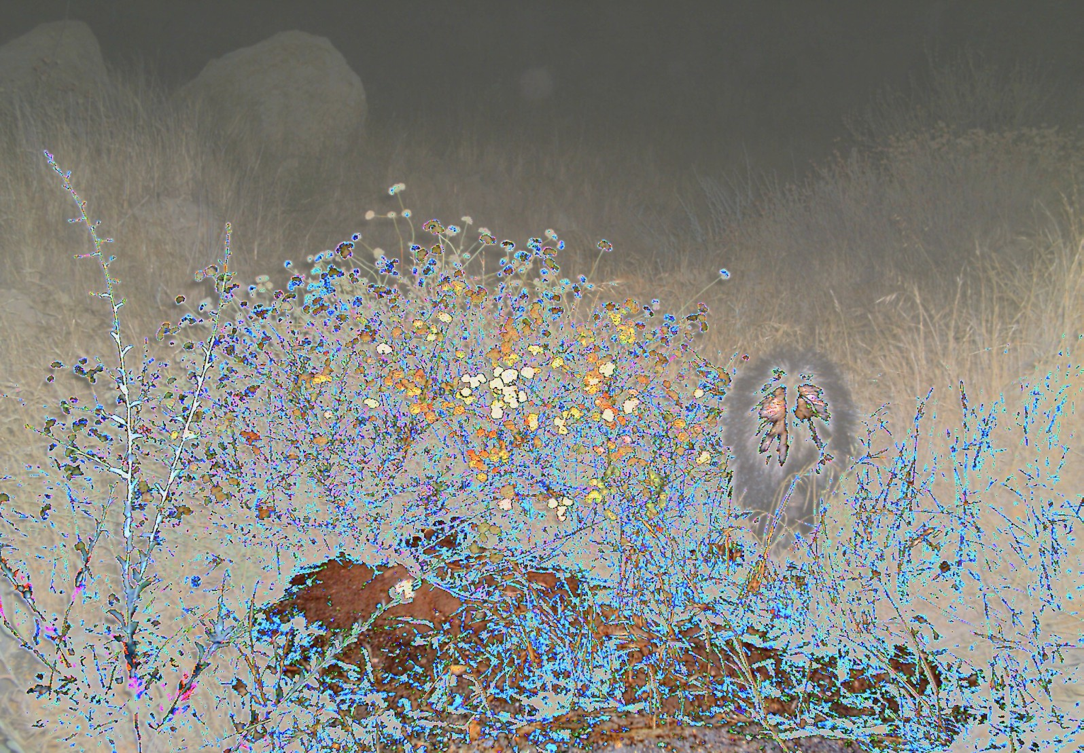
Challenges (A) -Camera Malfunctions
Sometimes the camera malfunctions, causing strange discolorations.

Slide 11
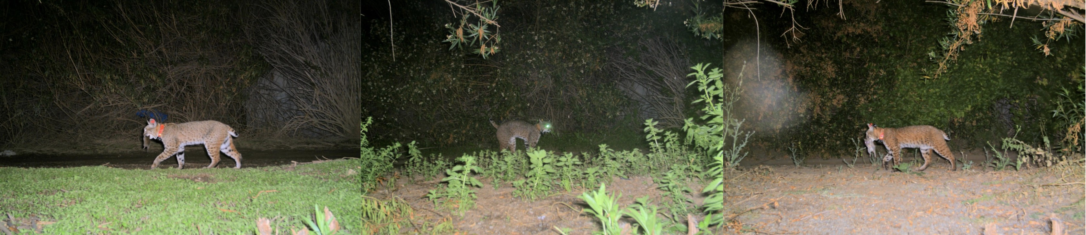
Challenges (A) -Temporal Changes
At any given location, the background changes over time as the seasons change. Below, you can see a single location at three different points in time.

Slide 12
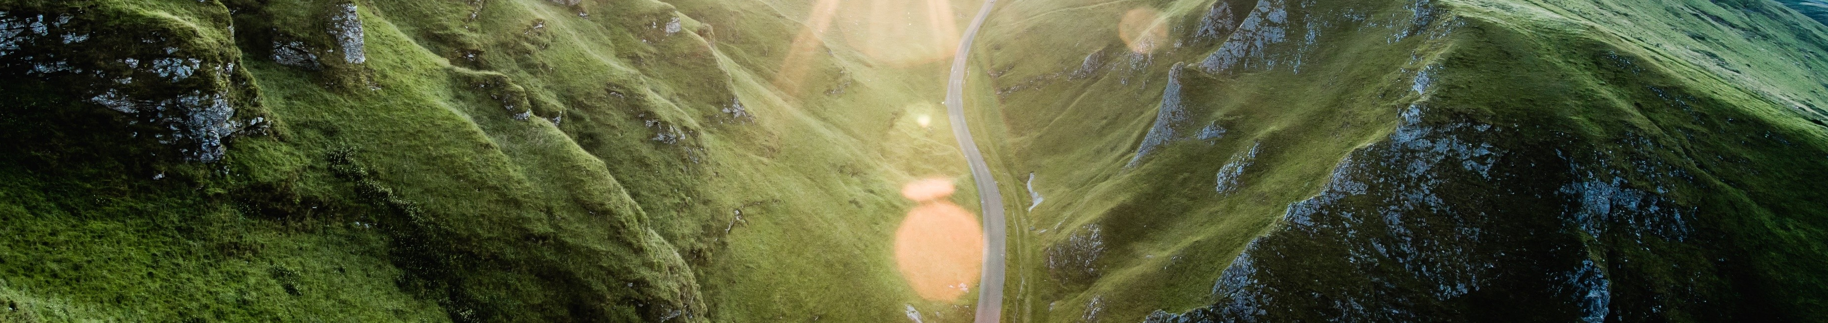
Challenges (A) -Non-Animal Variability
What causes the non-animal images to trigger varies based on location. Some locations contain lots of vegetation, which can cause false triggers as it moves in the wind. Others are near roadways, so can be triggered by cars or bikers.

Slide 13
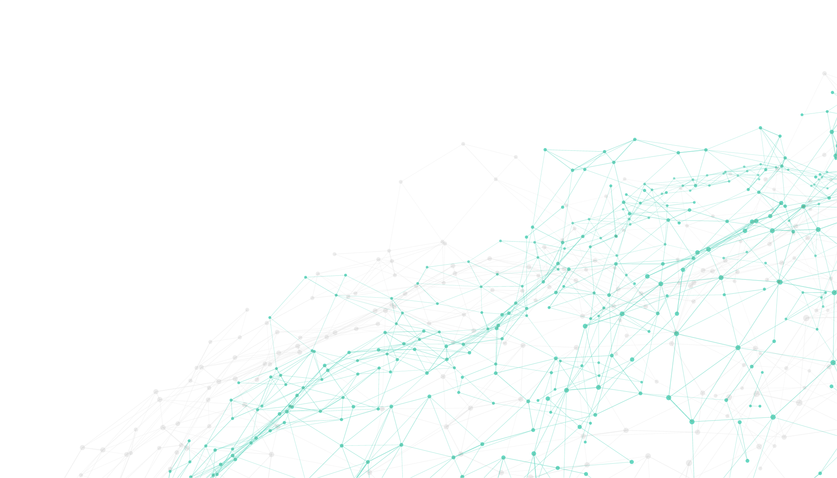
Exploratory Data Analysis – Training Set
Number of image files | 196,086
Number of entries in training csv | 196,299 | Looks like there are more entries than images
Number of image IDs in training csv | 196,086 | Some images appear more than once with different labels
Image widths | 1024
Image heights | 747, 748, 768
Number of sequences longer than 1 | 26,824 | Only 18% of sequences have more than one frame

Slide 14
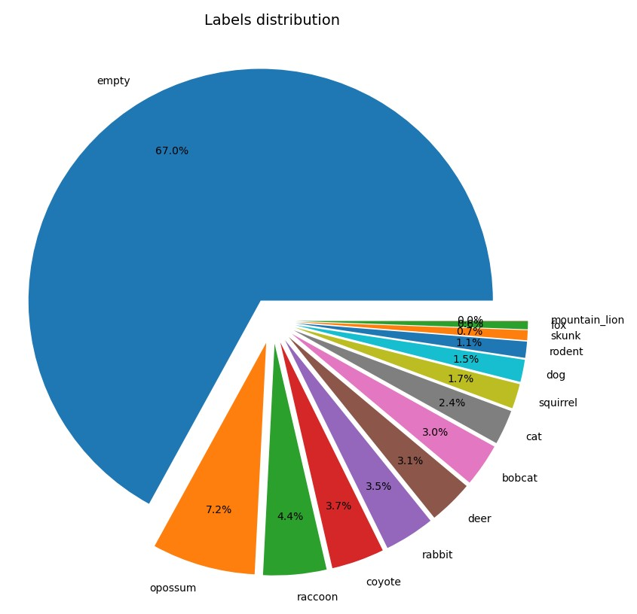
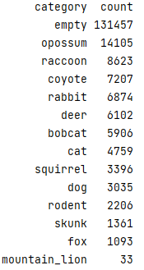
Exploratory Data Analysis – Training Set Imbalance
Several categories are severely under-represented
Only 14 labels out of 23 are present in the training set

Slide 15
Exploratory Data Analysis – Training Set Enrichment
To address challenge B, we have enrich the training data by inclusion of the “iNaturalist 2019”, as suggested in [1] and [2].
Number of image files | 25,263
Number of entries in training csv | 25,263
Number of image IDs in training csv | 25,263 | No duplicates
Image widths | 284 different values from 163 to 800
Image heights | 469 different values from 150 to 800

Slide 16
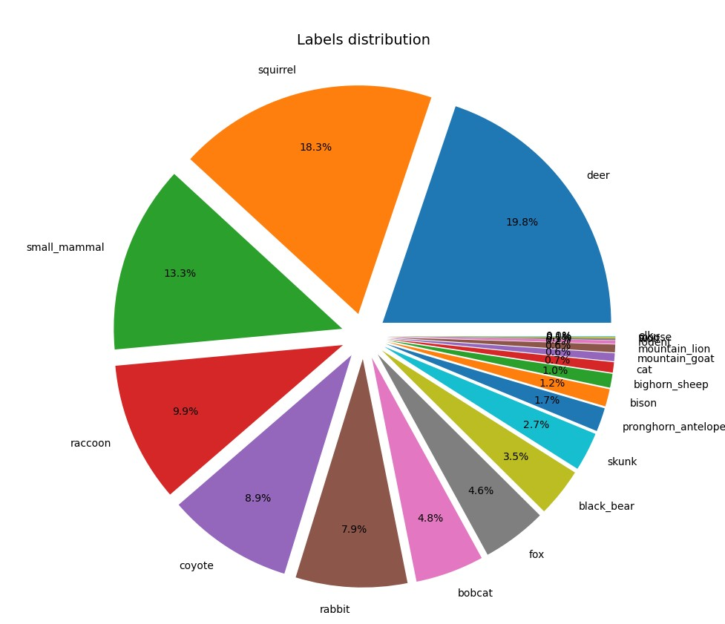
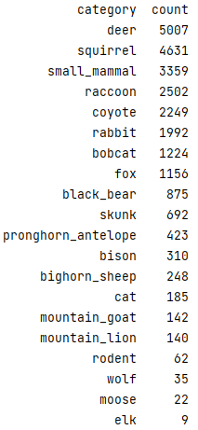
Exploratory Data Analysis – “iNaturalist 2019”
There are no empty images
20 labels out of 23 are present in this dataset

Slide 17
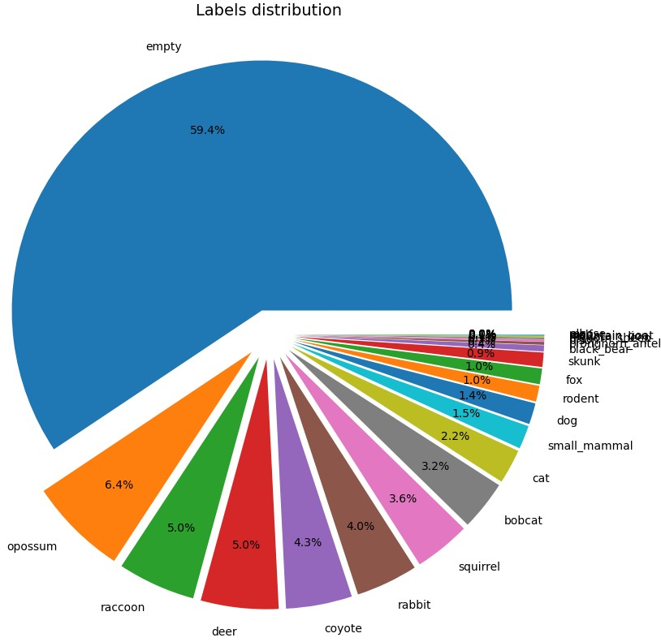
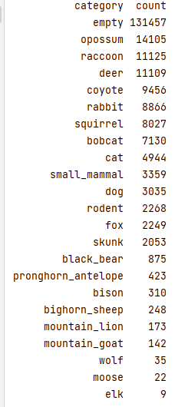
Exploratory Data Analysis – Enriched Training Set
Empty images are still more than half of the training set
23 labels out of 23 are present in this dataset

Slide 18
Data Pre-processing – Handling Label Imbalance
We have considered to improve label imbalance by under-sampling the empty images, and by oversampling labels with less than 2% representation.
However, those competition projects that tried re-balancing did not show improved results

Slide 19
Data Pre-processing - Address the “Camera Trap Challenges”
Auto-white Balance – can address illumination (especially in night images), small ROI, and weather conditions challenges
Improve contrast – can address illumination, motion blur, occlusion, and weather conditions challenges
Use of bounding boxes – can address illumination, motion blur, occlusion, small ROI, and weather conditions challenges

Slide 20
Data Pre-processing – Image Enhancement
Automatic White Balance
White balance is the process of removing unrealistic color casts, so that objects which appear white in person are rendered white in the image.
We use simple white balancing that works by independently stretching each of the input image channels to the specified range. For increased robustness it ignores the top and bottom 10% of pixel values
Improve contrast
We use CLAHE (Contrast Limited Adaptive Histogram Equalization) to improve image contrast.
This method allows for areas of lower local contrast to gain a higher contrast.

Slide 21
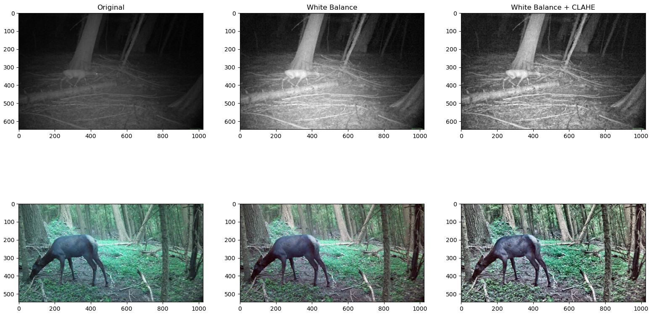
Data Pre-processing - Image Enhancement

Slide 22
Data Pre-processing – Bounding Boxes
We used bounding boxes detected by Microsoft AI for Earth MegaDetector, as proposed by the competition.
There was a problem – the data contained bounding boxes detected in the original images, and had to be scaled down to the images provided in the competition.
To find the original image sizes, we located the original CCT annotations json file.
However, we could not locate the original annotations for the test data (Idaho Fish and Game). Therefore, we deduced the scaling factor by assuming that it is the same for all images, and manually sampling some pictures.

Slide 23
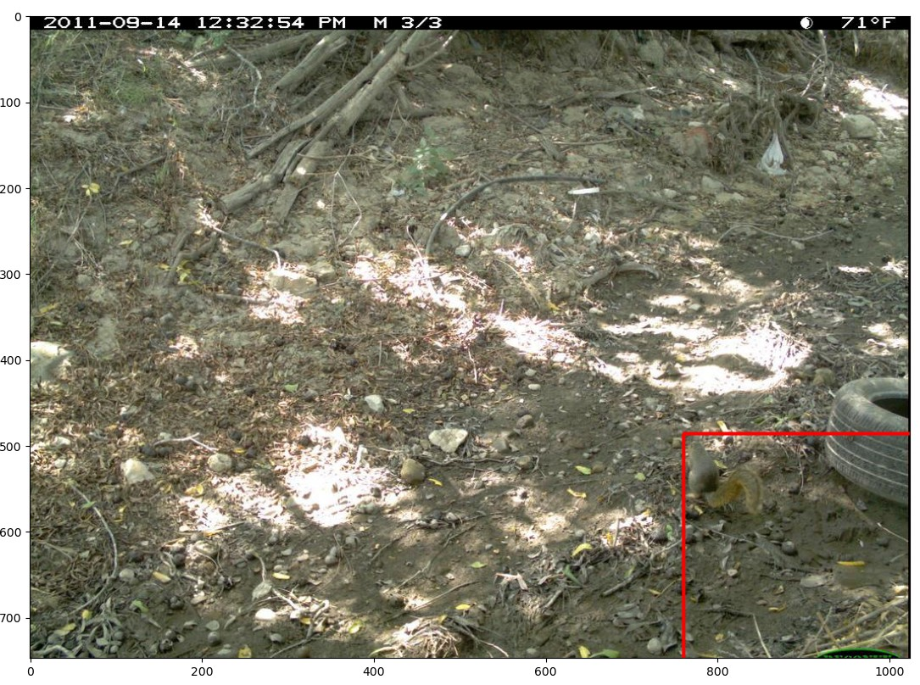
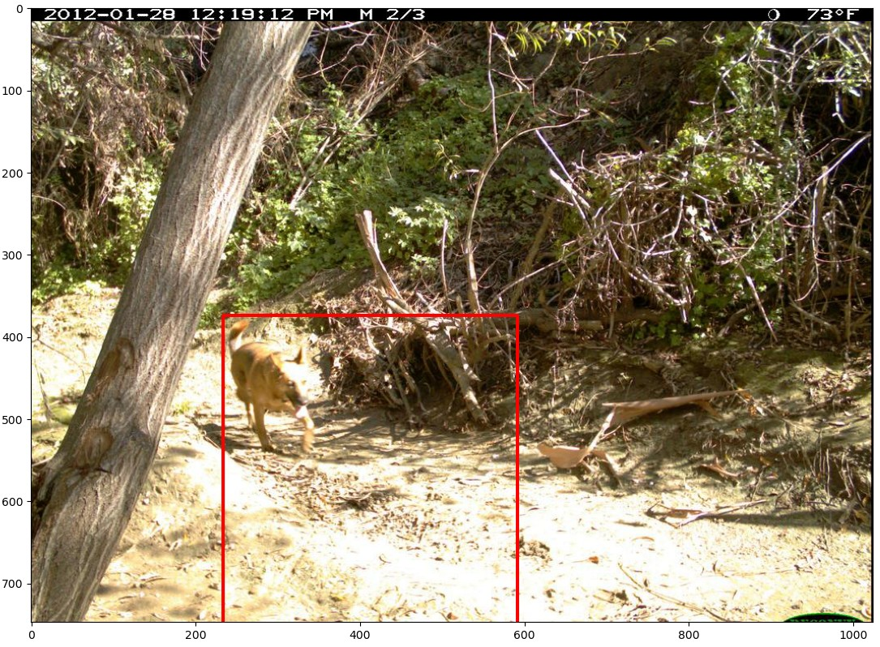
Data Pre-processing – Bounding Boxes

Slide 24
Model Architecture
Pre-trained model:
EfficientNetB0
EfficientNetV2B0
DenseNet121
Pooling
Dense
EfficientNetB0 and EfficientNetV2B0 were used with “imagenet” weights
DenseNet121 was used with “DenseNet-BC-121-32-no-top” weights from Kaggle
Notes:
בחרנו במודל להשתמש ברשת cnn.
לקחנו שלוש רשתות cnn מובנות והוספנו שתי שכבות שאותם אימנו Dense Pooling,
Pooling- שכבה זאת נועדה על מנת לצמצם את גודל הטנזור. היא מקבלת טנזור בגודל מסוים בתור קלט ומחזירה טנזור קטן יותר בתור פלט. יש כמה סוגי שכבות אגרגציה, כגון max pooling, average pooling ו-min pooling, כאשר max ו-average הם הפופולריים ביותר. סיבת השימוש באגרגציה היא בעיקר על מנת להוריד את "עלות" החישוב ולחסוך בזמן עיבוד.
Dense- שכבה רגילה ברשת נוירונים.

Slide 25
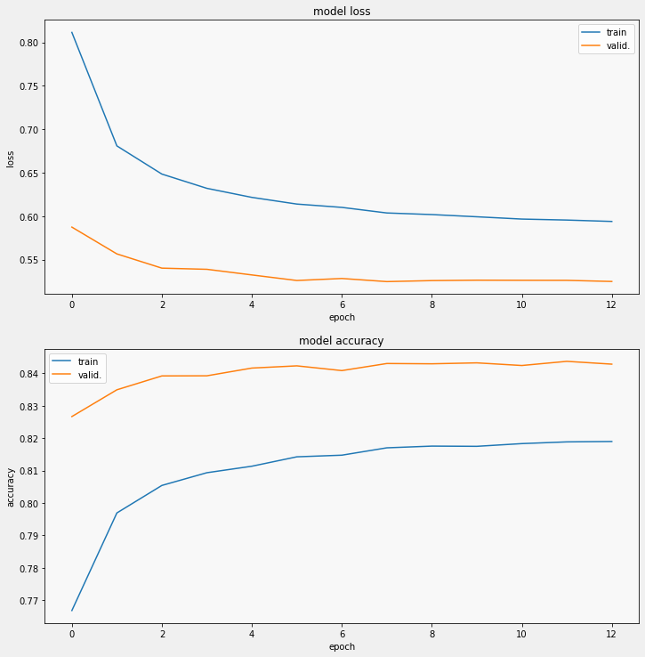
Model Architecture - EfficientNetB0
Notes:
תוצאות שלושת המודלים

Slide 26
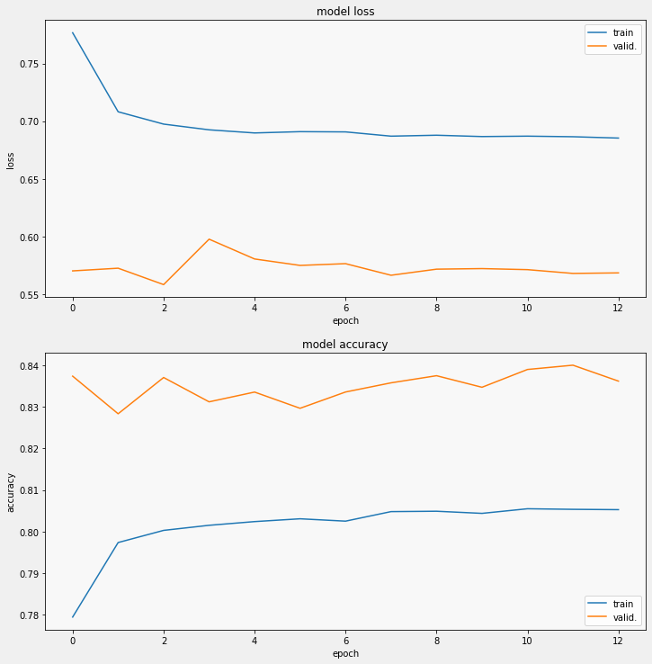
Model Architecture - EfficientNetV2B0

Slide 27
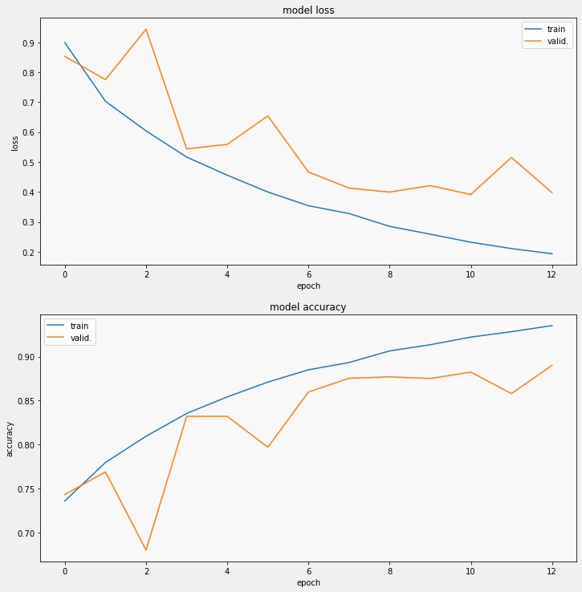
Model Architecture - DenseNet121

Slide 28
Using Meta-data to Improve Classification
We tried to improve image based classification by integrating meta-data in the process
Relevant meta-data:
Id, filename, image size, and sequence information are specific to each image
rights_holder values differ between train and test data
Locations are actually camera numbers from 1 up, and have same sequence in train and test data
This leaves date_captured as potential classification helper
Notes:
ניסינו לשפר את המודל המבוסס על רשת cnn על ידי שילוב נתונים בתהליך.
ראינו שרוב הנתונים קשורים לתמונה ספיציפית או רולוונטים רק לtrain או לtest חוץ מהתאריך והשעה.

Slide 29
Using date_captured to Improve Classification
Many animals are either diurnal or nocturnal
Therefore, if a diurnal animal is recognized on an image taken at night, there is a possibility of mistake, and vv.
The question is how to determine whether an image was taken during day or night.
Notes:
Diurnal – חיות יום
Nocturnal – חיות לילה
הרבה סוגים של חיות ניתן לסווג כחיות יום או לילה.
לכן, אם מזהים חיה יומית בתמונה שצולמה בלילה או הפוך, קיימת אפשרות שטעינו בסיווג.
כלומר המשימה שלנו היא לקבוע אם התמונה צולמה ביום או בלילה.

Slide 30
Test Data: Day or Night?
All test entries have date_captured data, and images were captured in Idaho.
Therefore, for each date we retrieved sunrise and sunset times, and used them to set an is_night flag:
We used suntime package that requires latitude and longitude for its computations
We used latitude and longitude of Boise, ID
Manual check of sample images showed some issues:
Time stamps in the form of 12:MM:SS may refer to either AM or PM
Some images had wrong date_captured
Notes:
עבור הtest:
כל התמונות צולמו במדינה idaho. לכן, עבור כל תאריך שלפנו את זמני הזריחה והשקיעה, והשתמשנו בהם כדי לקבוע האם התמונה צולמה ביום או בלילה.
היו כמה בעיות בסיווג לדוגמא:
חותמות זמן בצורה של 12 עשויה להתייחס לצהריים או לילה.

Slide 31
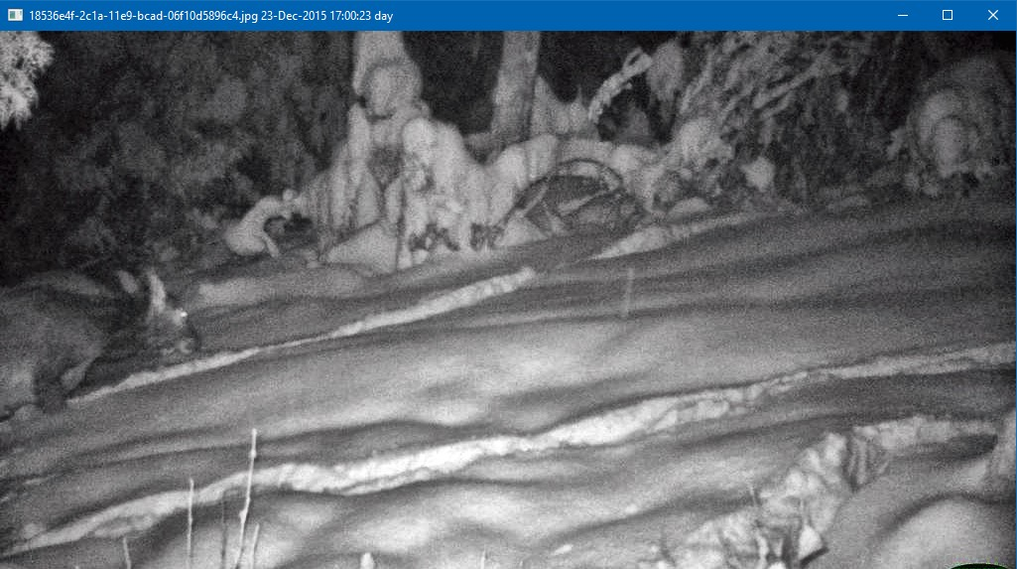
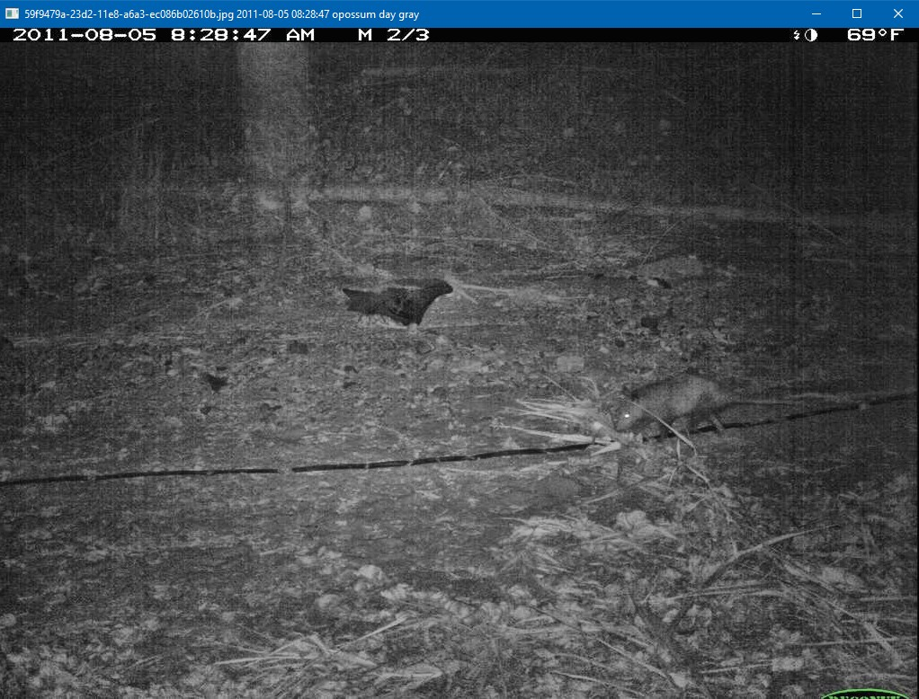
Training Data: Wrong date_captured
date_captured = 23-Dec-2015 17:00:23
date_captured = 2011-08-05 08:28:47
Notes:
לכן קיבלנו כמה טעיות בזיהוי

Slide 32
Gray-Scale vs. Color Images
To handle some day/night issues, we used is_gray_scale flag
We computed this flag comparing values on all channels. If they are equal, the image is gray-scale.
Some gray-scale images have color labels embedded by the camera (logo + time stamp). To get around this issue, we cropped 10% margins.
Notes:
דרך נוספת למציאת סיווג התמונה היא דרך בדיקת סקאלת הצבעים של התמונה.
השוואנו ערכים בכל הערוצי התמונה. אם הם שווים, התמונה בסקאלה שור-לבן ולכן כנראה צולמה בלילה.

Slide 33
Training Data: date_captured Issues
Wrong date_captured
We attempted to detect this issue by comparing date-based is_night flag the is_gray_scale flag
We determined whether the image is gray-scale by comparing values on all channels. If they are equal, the image is gray-scale.
However, it turned out that some cameras took grayscale pictures during day
The decision was to use date-based is_night as is in test data
12 AM or PM?:
In case of 12:MM:SS timestamps we used the following logic:
AM if is_gray_scale flag
PM otherwise
Notes:
ראינו שלפעמים קיבלנו תוצאות לא חופפות עבור שתי השיטות. (לדוגמא התמונה אפורה אך צולמה ביום (לפי הדגל is_night ). לכן היינו צריכים להוסיף קטריונים משלנו על מנת לדייק את התוצאות.

Slide 34
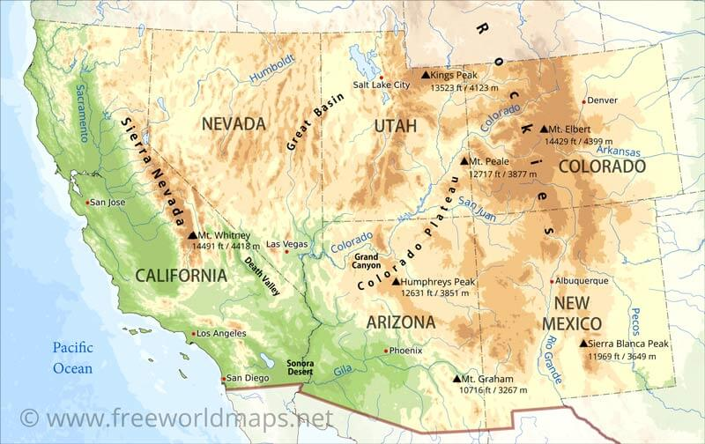
Train Data: Day or Night Challenges
Challenge | Solution
iNat meta-data does not contain date stamps | Use is_gray_scale flag
12 AM/PM | Same as test
Sunrise and sunset times: the CCT train images were captured in Southwest, which covers two time zones. | Use average sunrise and sunset times for San-Franciso (North-West corner), San-Diego (South-West corner), New-Mexico (South-East corner), and Colorado (North-East corner)
Notes:
אלו כמה אתגרים שנעמדו בפנינו ודרכי הפתרונות שלנו :
לחלק התמונות לא היה תאריך ושעה.
התמונות צולמו בכמה מדינות שונות ולכן זמני השקיעה זריחה שונים עבור כל תמונה.

Slide 35
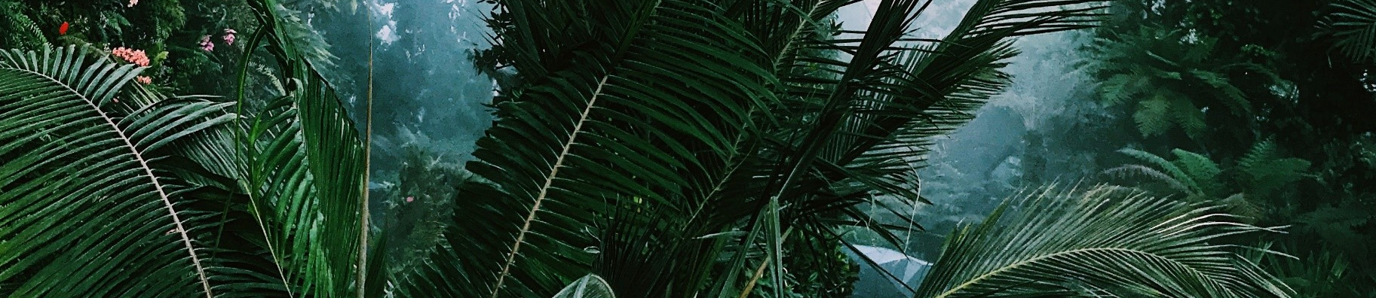
Correction Vector
For each category in train data, we have computed the frequency of images with is_night=True. This table also displays the frequency for is_night=False
Notes:
עבור כל חיה/קטגוריה חשבנו את ההסתברות של הימצאות החיה בלילה או ביום.

Slide 36
Correction Vector
category_id | Category name | is_night frequency | is_day_frequency
0 | empty | 27% | 73%
1 | deer | 32% | 68%
2 | moose | 5% | 95%
3 | squirrel | 1% | 99%
4 | rodent | 96% | 4%
5 | small_mammal | 1% | 99%
6 | elk | 0% | 100%
7 | pronghorn_antelope | 0% | 100%
8 | rabbit | 30% | 70%
9 | bighorn_sheep | 0% | 100%
10 | fox | 49% | 51%
11 | coyote | 48% | 52%
12 | black_bear | 1% | 99%
13 | raccoon | 78% | 22%
14 | skunk | 68% | 32%
15 | wolf | 3% | 97%
16 | bobcat | 50% | 50%
17 | cat | 52% | 48%
18 | dog | 12% | 88%
19 | opossum | 95% | 5%
20 | bison | 0% | 100%
21 | mountain_goat | 0% | 100%
22 | mountain_lion | 15% | 85%
Notes:
ואלו התוצאות שקיבלנו.

Slide 37
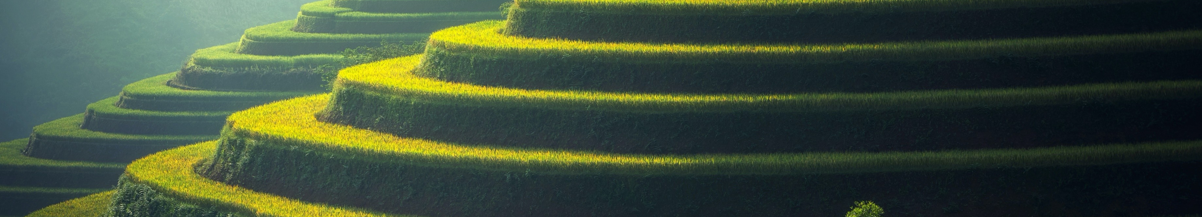
Empty Frequency
It is doubtful that the empty frequency in training is relevant to test
Therefore, we replace it with is_night frequency on the whole test dataset
Notes:
עבור התמונות הריקות חשבו את ההסתברות האם התמונה היא בלילה או ביום עבור הדאטא של הtest.

Slide 38
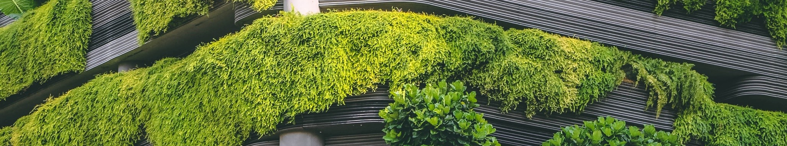
Boosting Prediction with Day/Night Frequency
For each image in test, we select either day or night coefficient vector
The resulting matrix has the same shape as the prediction matrix
We compute the final prediction by pairwise multiplication of the NN prediction with the correction matrix
Notes:
עבור כל תמונה בtest, אנו בודקים עם התמונה צולמה ביום או בלילה ובהינתן לכך בונים את השורה של המטריצה עם הההסתברות המתאימות לפי קטוגוריה.
אנחנו מכפילים בשיטה איבר איבר את מטריצת החיזוי שקיבלנו במודל במטריצה שבנינו

Slide 39
Day/Night Correction Evaluation
We have manually compared the original prediction with the boosted one on a sample of images:
Note that boosting has correctly reclassified empty to non-empty in 17% of the sample. This opens a possibility of attempting to reclassify such images using a network without empty images.
However, the frequency Right->Wrong corrections is approximately the same as that of Wrong->Right
Old category | New category | %
Right | Wrong | 11%
Wrong | Wrong | 80%
Wrong | Right | 9%
Empty | Non-Empty | 17%
Notes:
ביצענו בדיקה ידנית לראות אם שיפרנו את הסיווג

Slide 40
Results: Kaggle
Model | Day/Night Correction | Kaggle Private Score | Kaggle Public Score | Comment
EfficientNetB0 | No | 0.094 | 0.107
EfficientNetB0 | Yes | 0.098 | 0.112 | Best result. Day/night correction slightly improves the results.
EfficientNetV2B0 | No | 0.085 | 0.095
DenseNet121 | No | 0.092 | 0.104
DenseNet121 | Yes | 0.078 | 0.093 | Day/Night correction slightly deteriorates the results.
Notes:
תוצאות התחרות
הרשת הכי טובה היא EfficientNetB0 עם תוספת הבידקה יום/לילה.

Slide 41
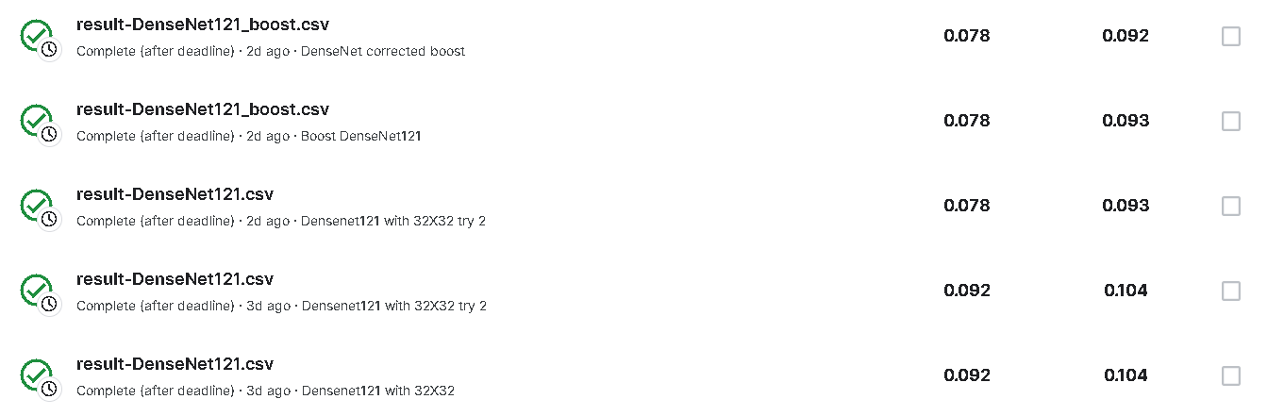
Kaggle-competition

Slide 42
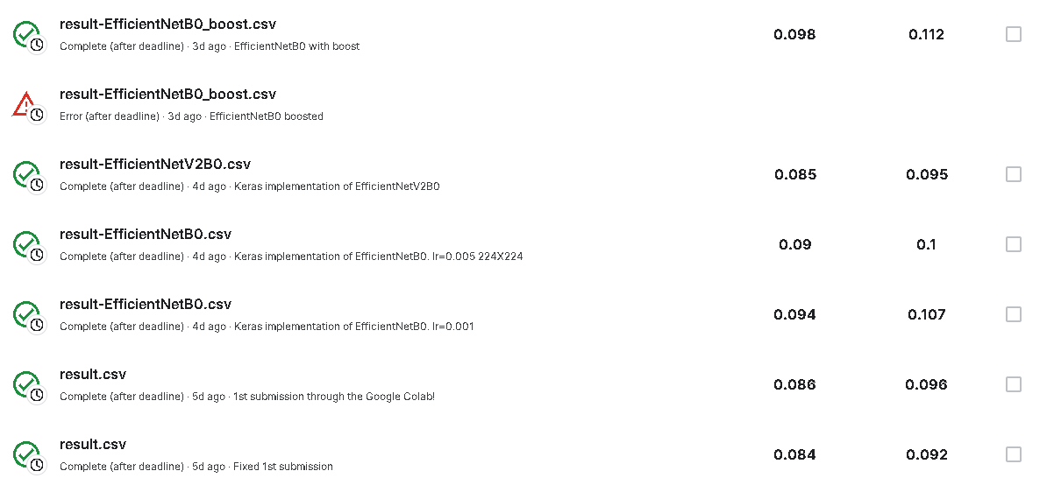
Kaggle-competition

Slide 43
Conclusions
Fully pre-trained networks produce sub-par results
Future: open some layers for training
DenseNet produced high accuracy during training, but average results during testing. We believe that this is due to overfitting on 32X32 images required by the pre-trained model.
The present implementation of dy/night correction did not produce significant improvement
Future: use more sophisticated algorithm for image day/night classification (e.g. separate model, histogram analysis)
Future:
Use data balancing (e.g. under-sampling for empty, and over-sampling of “rare” categories using augmentation)
Augment images for training
Use ensemble learning
Use additional layers trained on non-empty images only based on day/night correction results
Notes:
Sub-par – מתחת לממוצע
Augment: rotate, drop areas, smooth, shift
חלק מההמסקנות:
קיבלנו תוצאות נמוכות על ידי המודלים המאומנים של רשת cnn
ב-DenseNet קיבלנו accuracy גבוהה ותוצאה נמוכה בתחרות יכול לקרות בגלל overfitting.
הניסוי לשפר את התוצאות בעזרת יום ולילה לא שיפר בהרבה את התוצאות מהמודלים הקודמים.
שיפורים שיכלנו לבצע:
אימון המודל רק עבור תמונות עם חיות
ensemble learning
להאזן את הדאטא הקיים על ידי under-sampling/over-sampling

Slide 44
References
[1] “iWildCam 2019 Competition”, https://github.com/visipedia/iwildcam_comp/tree/master/2019
[2] “Welcome to iWildCam 2019 - FGVC6!”, https://www.kaggle.com/competitions/iwildcam-2019-fgvc6/discussion/86649
[3] G. Huang, Z. Liu, L. Van Der Maaten and K. Q. Weinberger, "Densely Connected Convolutional Networks," 2017 IEEE Conference on Computer Vision and Pattern Recognition (CVPR), Honolulu, HI, USA, 2017, pp. 2261-2269, doi: 10.1109/CVPR.2017.243.
[4] Tan, Mingxing, and Quoc Le. "Efficientnet: Rethinking model scaling for convolutional neural networks." In International conference on machine learning, pp. 6105-6114. PMLR, 2019.
[5] Thomas, Spencer A. "Combining Image Features and Patient Metadata to Enhance Transfer Learning." In 2021 43rd Annual International Conference of the IEEE Engineering in Medicine & Biology Society (EMBC), pp. 2660-2663. IEEE, 2021.

